Slide 1
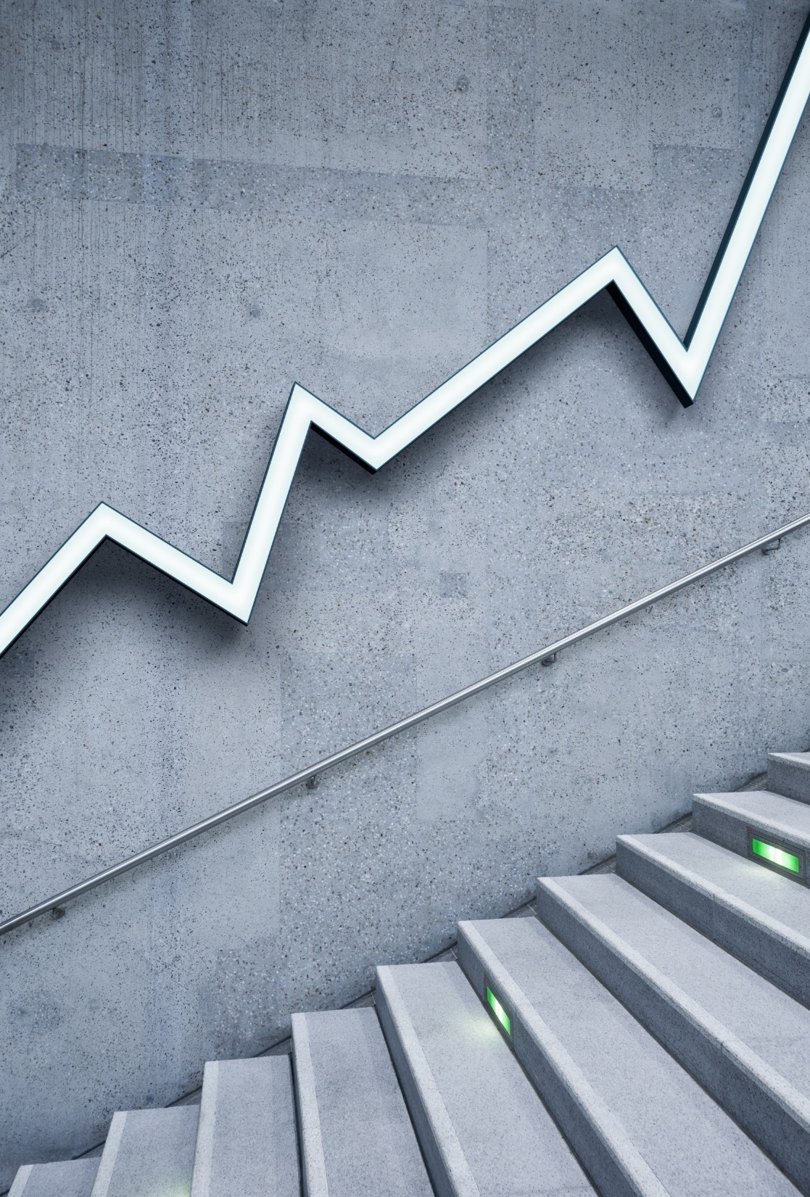
2023 Mechanics Training
Week 1 - Basics

Slide 2
The purpose of Week 1 is to introduce new officials to the basic mechanics of officiating.

Slide 3
POINTS OF EMPHASIS
Below are basic points of emphasis to remember regarding good mechanics:
Counting Players
Identifying Keys
Reading the Play
Marking Forward Progress Spot
Signals
Dead Ball Officiating

Slide 4
COUNTING PLAYERS
Officials are tasked with accounting for ALL players on the field every play:
4-man and 5-man crews
Wing Officials (+ Back Judge in 5-man) are responsible for counting the defense (11 or less)
Umpires (along with Referee) are responsible for counting the offense (11 or less)
*Counts are to be completed prior to the next snap during dead ball/substitution period.

Slide 5
IDENTIFYING PLAYERS I
Officials are tasked with identifying their keys prior to the snap once the offense is set in their formation
4-man Crews
Wing Officials are responsible for the eligible receivers on their side of the ball. (Receivers/Tight Ends)
Umpires are responsible for the Offensive Line (emphasis on G-C-G)
Referee is responsible for the Backs (QB/RB/FB) and blindside tackle

Slide 6
IDENTIFYING PLAYERS I (cont.)
Officials are tasked with identifying their keys prior to the snap once the offense is set in their formation
5-man Crews
Wing Officials are responsible for the outside eligible receiver on their side of the ball. They are also responsible for any slot receivers on the weak side of the formation.
Back Judge is responsible for the tight end or slot on the strong side of the formation.
Umpires are responsible for the Offensive Line (emphasis on G-C-G)
Referee is responsible for the Backs (QB/RB/FB) and blindside tackle

Slide 7
IDENTIFYING PLAYERS II
Wings must also identify which receivers are eligible on any given play. A receiver is eligible when:
They are in position at the end of the offensive line (i.e. Not covered up by another offensive player)
In the offensive backfield
*These eligible receivers may run downfield routes and/or receive a legal forward pass.

Slide 8
IDENTIFYING PLAYERS III
If the eligible receiver closest to the sideline to the wing official is “OFF” the line of scrimmage, they must signal to the opposite side of the field with an arm extended toward the backfield and hold until the snap or that receiver is either no longer off the line or is not the closest receiver to the sideline anymore.

Slide 9
READING THE PLAY I (WINGS)
In order to read the offensive play officials must remember the following:
SNAP – TACKLE – KEY
Wings must focus on the neutral zone to make sure no player encroaches prior to the snap.
Observe the action of the nearest tackle (Run Block/Pass Block)
Follow their key (Move downfield/Set and Read)

Slide 10
READING THE PLAY II (UMPIRES)
In order to read the offensive play officials must remember the following:
SNAP – TACKLE – KEY
Umpire must focus on the hand of the center/ball and ensure a legal snap.
Observe the action of the interior linemen (Run Block/Pass Block)
Follow their keys (Set and Read/Move towards LOS)

Slide 11
MARKING FORWARD PROGRESS I (WINGS)
At the end of the play (ball carrier down by contact or forward progress stopped inbounds or incomplete pass), wings must mark the forward most spot of progress.
This is done by coming to a stop with the downfield foot extended in front to the official at the proper yard line and their corresponding arm extended in the air to denote the play is over (Dead Ball Signal)
Other Dead Ball Signals include
Stop Clock Signal (extended arms overhead in a crossing motion towards the dead ball spot)– Used for forward progress past line to gain or out of bounds
Winding Clock Signal (large winding motion) – Used for forward progress plays near the sideline inbounds alone (or in conjunction with Stop Clock Signal on 1st downs)
Incomplete Pass Signal (extended arms out in a crossing motion towards the action)
Touchdown Signal (extended arms overhead) – Used when a ball carrier legally carries the ball over their opponent’s goal line
Safety Signal (Prayer signal overhead) – see Safety rules
Touchback Signal (extended hand above head waving back and forward) – see Touchback rules

Slide 12
MARKING FORWARD PROGRESS II (UMPIRES)
Umpires may have forward progress ONLY IF THE BALL IS DEAD AT THEIR FEET AND BOTH WINGS ARE BLOCKED.
Umpires will secure the football and then place the ball at the spot that the wing closest to the dead ball spot (laterally) gives them.
*Note that any forward progress spot marked outside of the hash marks are placed at the hash mark for the next down.

Slide 13
SIGNALS I (GAME RELATED)
Here are the types of signals used on the field:
Dead Ball Signal – Basic signal that denotes play is over (most common)
Stop Clock Signals – these signals stop the clock (variety of signals)
Traditional Stop Clock/First Down/Administrative or Injury Time Out Signal
Incomplete Pass Signal
Touchdown Signal
Safety Signal
Touchback Signal
Winding Clock Signal – this signal tells the press box to not stop clock on sideline plays.

Slide 14
SIGNALS II (COMMUNICATIVE)
Here are more signals used on the field:
Communicative Signals – Signals that send a message to other officials (non play related)
Arm/Fist extended – Good Count (11 players)
Arm/Fist extended (into backfield) – Nearest Receiver(s) Off the LOS
Fingers extended above head – Signals/Confirms Down

Slide 15
DEAD BALL OFFICIATING
The purpose of dead ball officiating is to efficiently set the teams/playing field back up to run the next play:
Whistle/Dead Ball Signal/Forward Progress Spot
Umpire Secures Ball and Spots It For Play
Off Ball Officials Help with Herding Players back to their side of the ball
Confirm New Down
Return to Positions
Acknowledge Substitutes/Count Players/Identify Keys

Slide 16
NOTES
Here are items of importance:
Whistle etiquette – don’t officiate with your whistle in your mouth
Flag etiquette – hide your flag until you are ready to use it
Read/React – move with confidence
Crisp signals – big bold signals stand out
Get a routine to get from dead ball period back to presnap.
Know Your Keys
Know Your Signals
Know Down and Distance EVERY PLAY!

Slide 17
VIDEO REFERENCES
Video Presentation on Youtube:
Week 1 Mechanics Training - Powerpoint

Slide 18
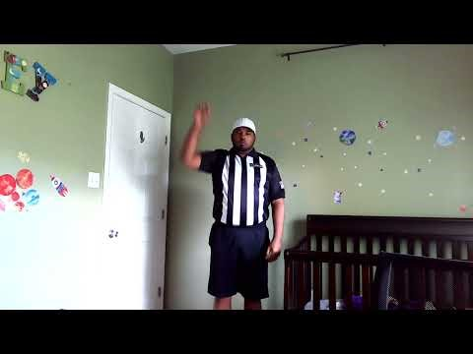
VIDEO REFERENCES
Video Presentation on Youtube:
Week 1 Mechanics Training – Basic Signals

